Slide 1

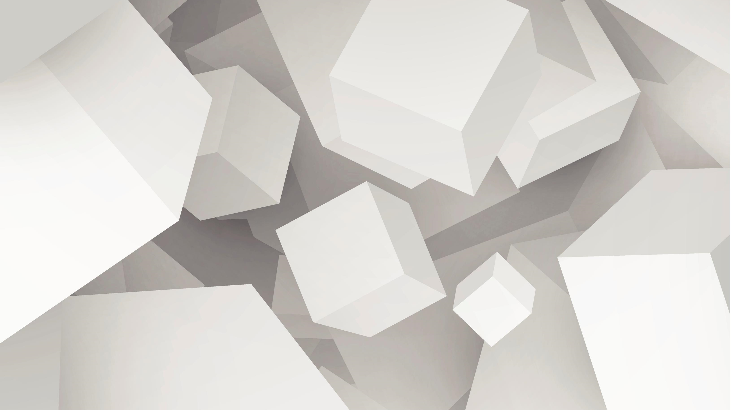
Docker
Introduction to Docker

Slide 2
Lesson Agenda
The problem
Solution
Introduction to containers
VM vs Containers
Introducing Images

Slide 3
The problem
Compatibility and dependency issues with applications
Long Set-up time
Need for multiple environments for Development, Testing and Production

Slide 4
The solution
Docker allows each application to run in a separate container on the same host(VM/OS).
The containers have the requisite environment(Dependency) for the survival of that application.
These containers are setup in minutes.

Slide 5
Introduction to Containers
Each container resides in and shares same OS kernel. They can have different processes, networks and mounts configured.
There are many types of containers such as LXC,LXD, LXCFS etc.
Before version 0.9, docker used LXC but since then uses the libcontainer.
This is being developed by docker.io in association with industry heavyweights like google, red-hat, ubuntu to name a few.
libcontainer is written in the ‘Go’ language along with c/c++.
Docker provides various tools to set-up the containers.

Slide 6
All operating systems have essentially 2 components,
OS kernel – used for hardware communication
Some Softwares – used to provide features
For example all linux flavours like fedora, centOS, Ubuntu have a linux kernel. The software on top of this kernel differentiates them from one another.
Therefore any linux host will be able to support containers of any linux distribution.

Slide 7
We cannot use a container, on a host with a different kernel.
For example, we cannot use a windows based container on a linux host.
Note:- Now windows based host supports the linux based container because of one of two reasons --:
A lightweight linux VM running on Hyper-V(Docker client calls docker daemon on linux VM)
Configuring and using WSL (Windows Sub-system for Linux)
Since behind the scene, Linux core is used, therefore, line one of this slide is still valid.
The restriction of having similar kernel to run container is not a disadvantage, as the docker was never meant to be a virtualization solution.
Docker is meant to package and containerize applications to run anytime and anywhere.

Slide 8
Docker Introduction
The company started out as a platform as a service (PaaS) provider called dotCloud. The dotCloud platform was built on Linux containers. To help create and manage these containers, they built an in-house tool that they eventually nick-named “Docker”.
In 2013 they got rid of the struggling PaaS side of the business, rebranded the company as “Docker, Inc.”, and focused on bringing Docker and containers to the world

Slide 9
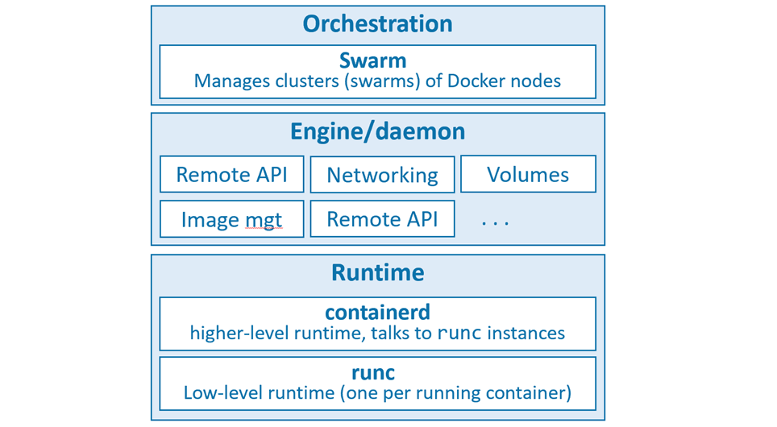
Docker Architecture
The runtime
The daemon (a.k.a. engine)
The orchestrator

Slide 10
The runtime operates at the lowest level and is responsible for starting and stopping containers
Docker implements a tiered runtime architecture with high-level and low-level runtimes that work together.
runc interfaces with the underlying OS to start and stop containers. Every running container on a Docker node has a runc instance managing it.
containerd manages the entire lifecycle of a container, including pulling images, creating network interfaces, and managing lower-level runc instances.

Slide 11
A typical Docker installation has a single containerd process controlling the runc instances associated with each running container.
The Docker daemon sits above containerd and performs higher-level tasks such as; exposing the Docker remote API, managing images, managing volumes, managing networks, and more…
A major job of the Docker daemon is to provide an easy-to-use standard interface that abstracts the lower levels.
Docker also has native support for managing clusters of nodes running Docker. These clusters are called swarms and the native technology is called Docker Swarm.
The OCI(Open Container Initiative) is a governance council responsible for standardizing the low-level fundamental components of container infrastructure

Slide 12
VM vs Container
In a Virtual Machine(VM), the Hypervisor sits on top of the Hardware whereas in the container, there is no need for any Hypervisor
Each VM has its own copy of the OS whereas the container works on the host OS.
Resource consumption of VM is more than the container.
VM’s are slower to boot than the container(OS specific resource loading takes more time)
VM’s allows us to load any OS on a host(no kernel restriction).

Slide 13
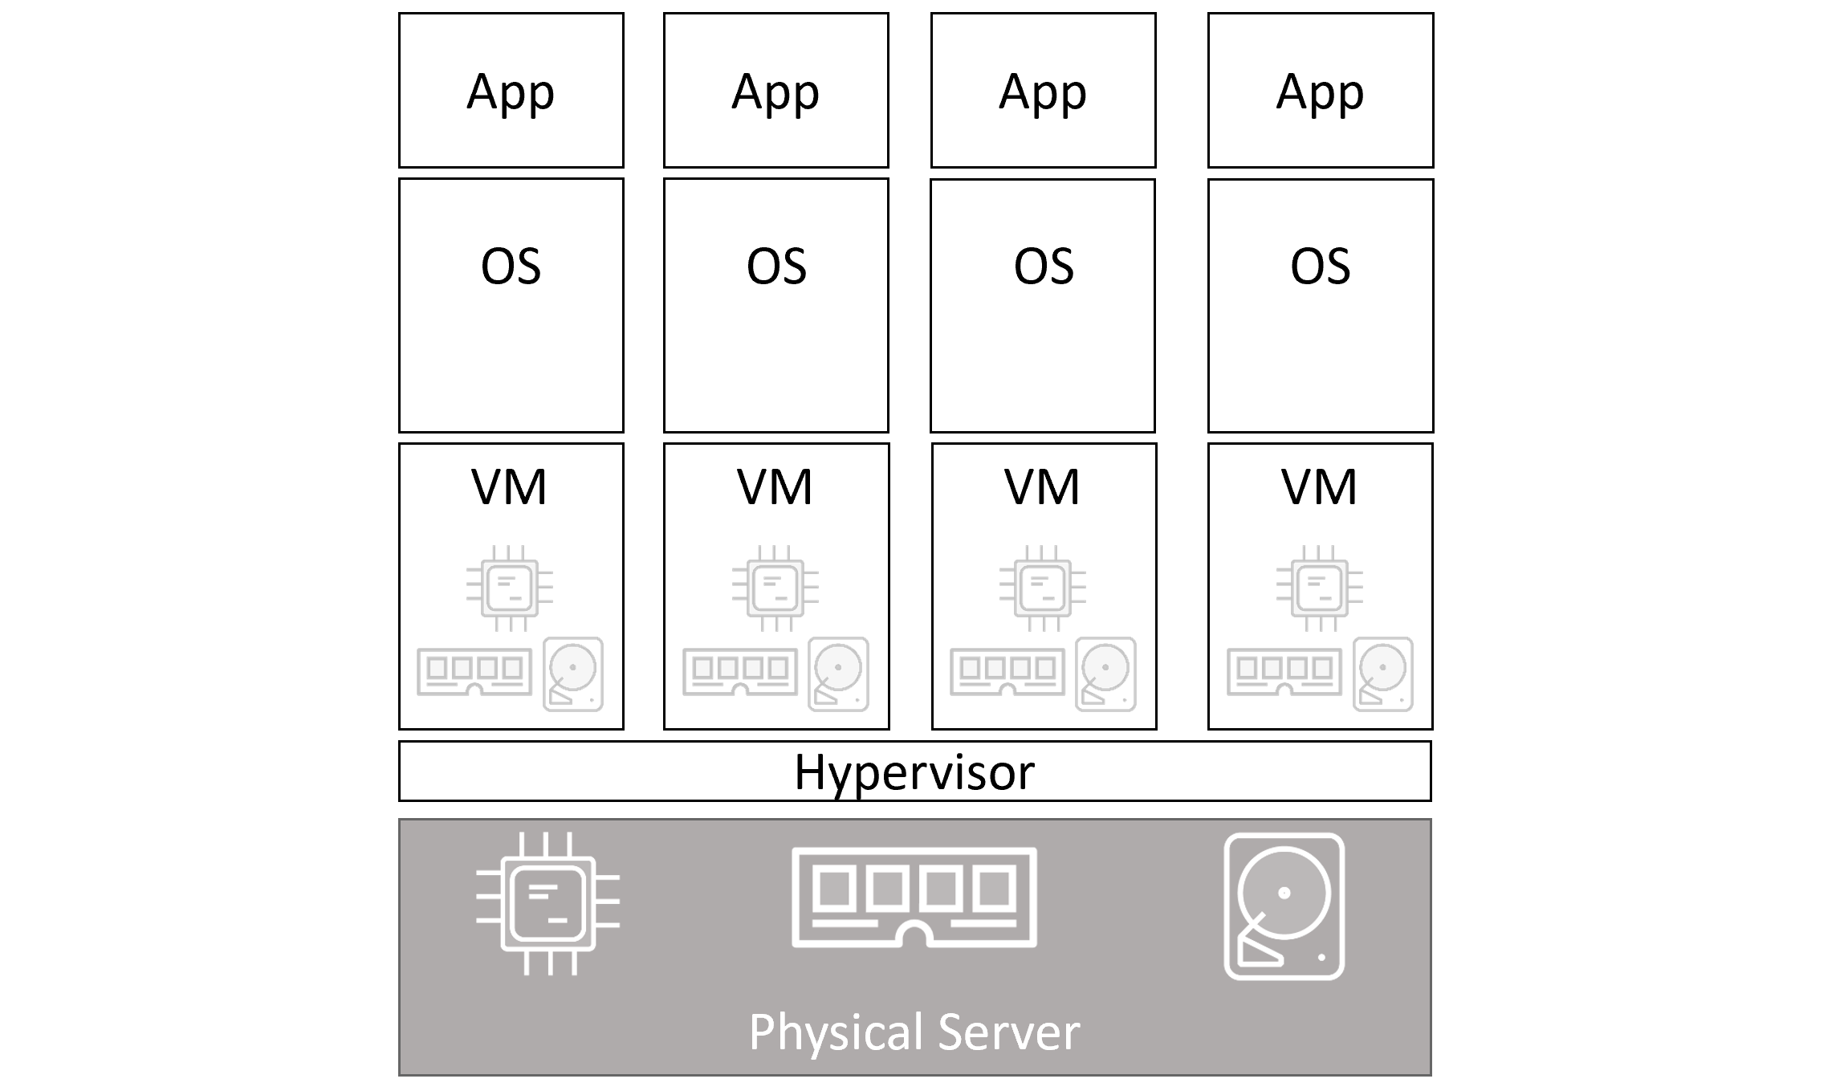
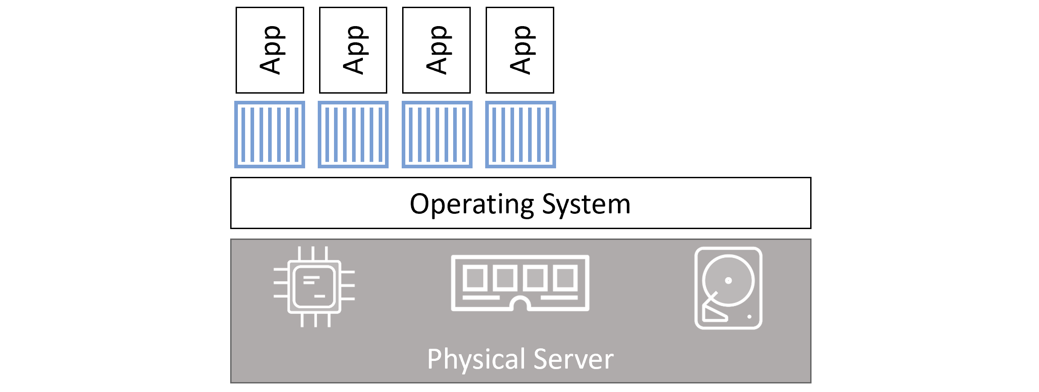
VM vs Container model
Virtual machine
Container Model

Slide 14
Introducing Images
Docker has two editions,
Community Edition – Free
Enterprise Edition -- Paid
Most Organizations provide images of their products and load them in public docker repositories like dockerhub.
Retrieving and loading images are as simple as running a command.
We can imagine an image to be like a template/package which is used to create one or more containers. Isolated instances of the images are containers.

Slide 15
Demonstration-1
Let us now install Docker.

